Slide 1


A CyBOK-Based Framework for Managing Cloud Security
Risks in Higher Education Institutions
Prepaerd By : Mohammed Ali Harahsheh MSc Cyber Security – Research Methods

Slide 2



The Research Problem: A Growing Digital Challenge
Universities' Reliance on Cloud Services
Universities rapidly adopt cloud platforms (Microsoft Azure, AWS, Google Cloud) for essential services: learning management systems, student information systems, research databases, and collaborative platforms.
This transformation offers benefits: enhanced scalability for growing student populations, flexible resource allocation during peak periods, and cost-efficient subscription models.
Digital Risks
Despite these advantages, this move to digital systems brings significant risks:
ENISA: 60% increase in ransomware attacks on higher education (2021-2023).
EDUCAUSE: 73% of universities faced a cloud-related security issue last year.

Slide 3
Devastating Real-World Consequences
University of Maastricht (2019)
UCSF Medical School (2020)
Lincoln College, USA (2022)
Paid $1.14 million. Attackers locked down research computers, including data for COVID-19 studies.
Permanently shut down after a ransomware attack, closing its doors after 157 years and impacting hundreds of students.
Paid €200,000 ransom. Ransomware locked down their systems, stopping normal activities for weeks and making students take exams on paper.
These events show a serious truth: universities and colleges, unlike businesses, don't have enough resources to fight cyber threats, which leaves them especially vulnerable.

Slide 4

Why Higher Education Is Different
1
2
Companies vs. Universities Security
Special Challenges
Corporations use strong security systems. Universities, however, focus on open and collaborative environments.
Open, collaborative culture
Decisions made by many different groups
Limited budgets
Academic freedom priorities
Many different types of users needing access
Higher education faces unique risks due to its specific setting, requiring security plans designed just for its needs.

Slide 5
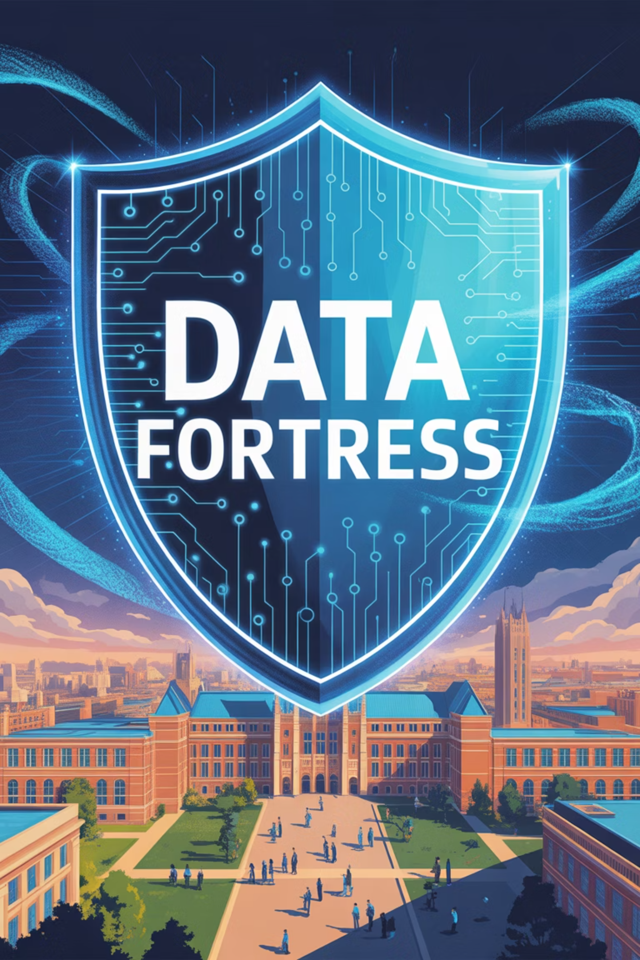
Why This Research Matters
Financial Impact
Data breaches cost an average of $3.65 million, damaging university reputations and requiring long recovery.
Compliance Challenges
Higher education struggles to meet regulatory rules like GDPR and NIST due to diverse departments and tight budgets.
Academic Contribution
This study links cloud risks in higher education to key cybersecurity knowledge areas (CyBOK).
Policy Development
The research offers evidence-backed advice for budget-constrained universities, proposing cost-effective security solutions.

Slide 6

Central Research Question
How can universities manage cloud security risks and maintain compliance?
1
2
3
Identify Risks
Align with Standards
Propose Solutions
What are the key cloud security risks for universities?
How do these risks align with cybersecurity guidelines (CyBOK, NIST 800-53)?
What effective solutions can mitigate these risks within university constraints?

Slide 7





Research Goals & Steps
This research aims to understand cloud security risks in universities and suggest practical, research-backed solutions for these settings.
Review Existing Research
Carefully examine current studies on cloud risks in universities, building on important previous research (Alharthi et al., 2022; ENISA, 2023).
Categorize Risks
Group the identified risks using CyBOK's categories to create a full list of university-specific risks.
Combine Research Methods
Use a strong research approach combining different methods, including surveys (for numbers), interviews (for perspectives), and analyzing existing data.
Assess Security Guidelines
Check how well security guidelines like NIST 800-53 and ISO/IEC 27017 work in university settings.
Create a Custom Guide
Provide a complete guide for classifying and reducing risks specifically for universities.

Slide 8

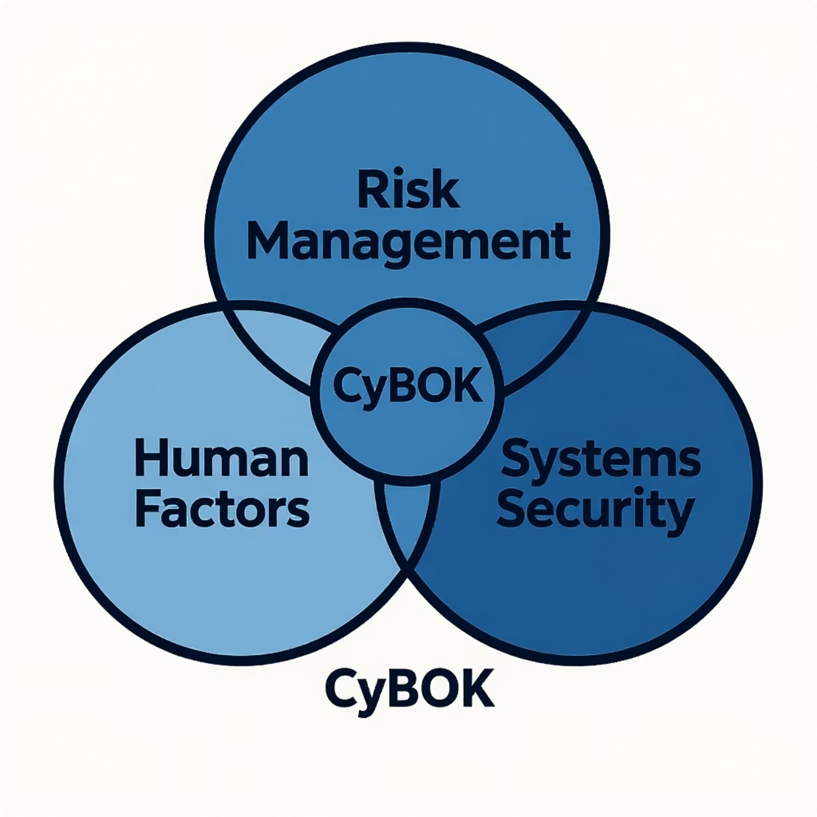

Key Gaps in Existing Research
What Current Research Shows
Existing research highlights general cybersecurity challenges, but often lacks a specific focus on universities:
ENISA (2023): Major global risks include incorrect system setups, insider threats, and ransomware.
Alharthi et al. (2022): Unique university issues include lack of central control and insufficient resources.
CyBOK (2021): Cloud security involves management and human behavior, not just technology.
Policy Implementation Gap
EDUCAUSE (2022) found only 38% of US universities have clear cloud service policies, versus 70% of private companies.
This project addresses these gaps by creating a custom, CyBOK-based plan to reduce risks for universities.

Slide 9












Understanding Cloud Security Risks for Universities
Data Breaches
Setup Errors
Unauthorized access to private information.
Misconfigurations, weak access, or default passwords.
Leadership Issues
Insider Risks
Unclear rules, lack of accountability, or inconsistent policy application.
Misuse of systems by university personnel, intentional or accidental.
Access Control
Rule Breaking
Managing who can access systems and what they can do.
Failure to meet security and privacy regulations.

Slide 10



Cloud Risk Taxonomy in Higher Education
External Risks
Internal Risks
Compliance Risks
Ransomware
Insider misuse
GDPR
Phishing
Misconfigurations
UAE Data Law
HEI's face interconnected layers of cloud risks requiring integrated controls (ENISA, 2023).

Slide 11

Current Security Strategies
Challenges in Security
Low use of Multi-Factor Authentication (MFA) (only 41% globally)
Limited use of 'Zero Trust' security
Inconsistent security training
Limited resources (staff, budget)
New Opportunities
Using 'Zero Trust' security to prevent unauthorized access across systems (needs adjustments for education)
Creating security plans and risk management guidelines specifically for higher education

Slide 12




Standards & Framework Analysis
NIST SP 800-53
ISO/IEC 27017
Shared Responsibility Models
Comprehensive, but often too complex and resource-intensive for universities.
Cloud security guidance lacking university-specific implementation details.
Cloud providers secure infrastructure; universities manage user access and devices.
Implementation Challenge
Many universities use basic IT rules, not detailed security plans. Fewer than 30% of institutions completely follow ISO security plans (EDUCAUSE, 2023).
In practice, many HEIs fail to fully adopt NIST/ISO due to limited budgets, staff expertise, and decentralised governance structures.
These frameworks, especially NIST SP 800-53 (2020) and ISO/IEC 27017 (2015), will be compared against CyBOK categories to identify practical controls for universities.

Slide 13


Research Methodology
This study uses a blend of research methods to understand cloud security challenges in higher education.
Surveys
Interviews
Review of Existing Information
We'll survey 50-100 IT/security professionals to understand risks and how they use security systems.
We'll conduct 10-15 interviews with security leaders and IT managers to discuss challenges related to culture, management, and money.
We'll analyze ENISA reports, NIST standards, EDUCAUSE surveys, and reports on security incidents.
Each research objective is matched with a specific method:
01
02
03
To identify cloud risks → literature review and staff surveys.
To map risks to frameworks → comparative analysis of CyBOK, NIST, and ISO controls.
To design a practical guide → NVivo thematic analysis and expert validation interviews.
This ensures a direct connection between aims and methodology.
This approach ensures we gather strong, reliable results by confirming findings through multiple research methods.

Slide 14
Data Collection Plan
Surveys
1
Survey 50-100 IT/security professionals on risks, guideline use, and readiness.
Interviews
2
Interview 10-15 IT leaders on management, resources, and implementation challenges.
Secondary Sources
3
Review ENISA, EDUCAUSE, NIST reports, and past security incidents.
It's equally important to present and handle data ethically and accurately — which I'll explain next.

Slide 15
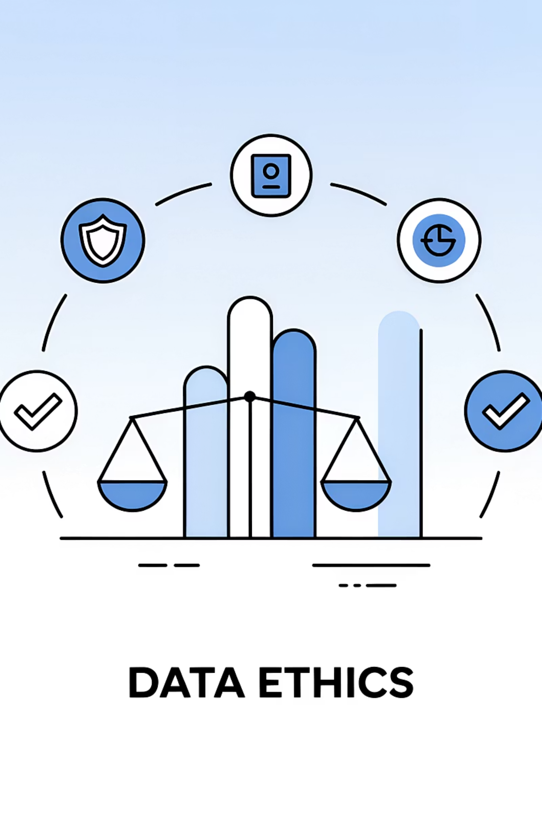
Data Visualisation & Ethics
All visuals and datasets will follow ethical guidelines.
Charts will follow ethical standards using the Financial Times Visual Vocabulary for clear design.
1
Outliers and missing data will be treated transparently to avoid bias.
2
For qualitative data, only anonymised themes will appear.
3
For quantitative data, no selective filtering or statistical forcing will be used.
4
This approach follows Eurostat and GDPR principles for responsible data presentation.

Slide 16

Data Analysis Framework
Quantitative Analysis
Descriptive statistics and chi-square tests to identify patterns and differences across institution size, region, and cloud maturity.
Qualitative Coding
NVivo to identify common themes: management challenges, obstacles to rules, and cultural influences.
Comparing & Confirming
Triangulation of survey, interview, and secondary data to confirm findings and identify divergences.
Limitations & Mitigation
Limitations
Mitigation
Small number of participants
Comparing with other data sources
Challenges in getting institutional access
Working with academic partners
Potential for biased answers
Keeping responses anonymous and confidential

Slide 17

Ethics
Our research adheres to strict ethical principles, safeguarding participant rights, privacy, and legal compliance.
Data Protection
Ensure compliance with international and local data protection regulations (e.g., GDPR) through legal and transparent handling.
Informed Consent
Obtain explicit consent, clearly outlining study details, data usage, and the right to withdraw.
Anonymization
Anonymize all collected data by removing identifying details to protect participant privacy and confidentiality.
Risk Mitigation
Proactively identify and mitigate potential risks to ensure participant safety and well-being.

Slide 18
Research Timeline
Weeks 1-4
Weeks 9-12
Completing proposal & ethics approval
Analyzing & checking data
1
2
3
4
Weeks 5-8
Weeks 13-16
Launching surveys & conducting interviews
Final report writing & submission

Slide 19
Expected Research Contributions
Academic Impact
Practical Solutions
Policy Alignment
Connects cybersecurity ideas with real-world application, adding to current knowledge by using common cybersecurity guidelines.
Provides useful and affordable strategies for universities with limited budgets.
Helps universities meet legal requirements, such as GDPR, UAE Data Protection Law, and other international standards.

Slide 20

Conclusion
Cloud Adoption: Benefits and Risks
offers benefits like scalability, flexibility, and efficiency but also brings risks such as data leaks, incorrect settings, and threats from within the organization.
Unique University Challenges
universities operate in open and decentralized environments that value academic freedom; cultural, leadership, and budget limitations make it hard to adopt security measures. They face bigger choices between being open and being secure, compared to businesses.
Limitations of Current Guidelines
While security guidelines like NIST SP 800-53 and ISO/IEC 27017 exist, most universities only partly use them.
Our Study's Contribution
our approach, combining different research methods, guarantees reliable results. Our findings offer practical, affordable, and well-researched solutions specifically for cloud security risks in higher education.

Slide 21
References
Alharthi, A., Alassafi, M., Walters, R. and Wills, G. (2022) ‘An overview of cloud services adoption challenges in higher education institutions’, Future Internet, 14(7), p.206. Available at: https://doi.org/10.3390/fi14070206 (Accessed: 4 October 2025).
CyBOK (2021) The Cyber Security Body of Knowledge. University of Bristol. Available at: https://www.cybok.org (Accessed: 4 October 2025).
ENISA (2023) Cloud Security Threat Landscape 2023. European Union Agency for Cybersecurity. Available at: https://www.enisa.europa.eu (Accessed: 4 October 2025).
IBM (2023) Cost of a Data Breach Report 2023. IBM Security. Available at: https://www.ibm.com/reports/data-breach (Accessed: 4 October 2025).
EDUCAUSE (2022) Cloud Computing in Higher Education: 2022 Survey Results. Available at: https://www.educause.edu/research-and-publications/research/2022/cloud-computing-in-higher-education (Accessed: 4 October 2025).
EDUCAUSE (2023) Top IT Issues 2023: Security and Cloud Risks in Higher Education. Available at: https://www.educause.edu/research-and-publications/research/2023/top-it-issues (Accessed: 4 October 2025).
Jisc (2020) ‘University of Maastricht ransomware attack’. Available at: https://www.jisc.ac.uk/news/university-of-maastricht-pays-ransom-2020 (Accessed: 4 October 2025).
UCSF (2020) ‘UCSF pays ransom to hackers after data breach’. Available at: https://www.ucsf.edu/news/2020/07/ucsf-pays-ransom-hackers-after-data-breach (Accessed: 4 October 2025).
Inside Higher Ed (2022) ‘Lincoln College to close following cyberattack’. Available at: https://www.insidehighered.com/news/2022/05/09/lincoln-college-closes-following-ransomware-attack (Accessed: 4 October 2025).

